Slide 1
Photonic MBQC in the NISQ Era
Yuxuan Zhang
PhD Intern
Jun. 2022

Slide 2
To characterize quantum computers:
Scale: the number of qubits available
Speed: time cost per elementary gate action
Reliability: the ability to faithfully perform arbitrarily assigned tasks
Need to improve on all aspects!

Slide 3
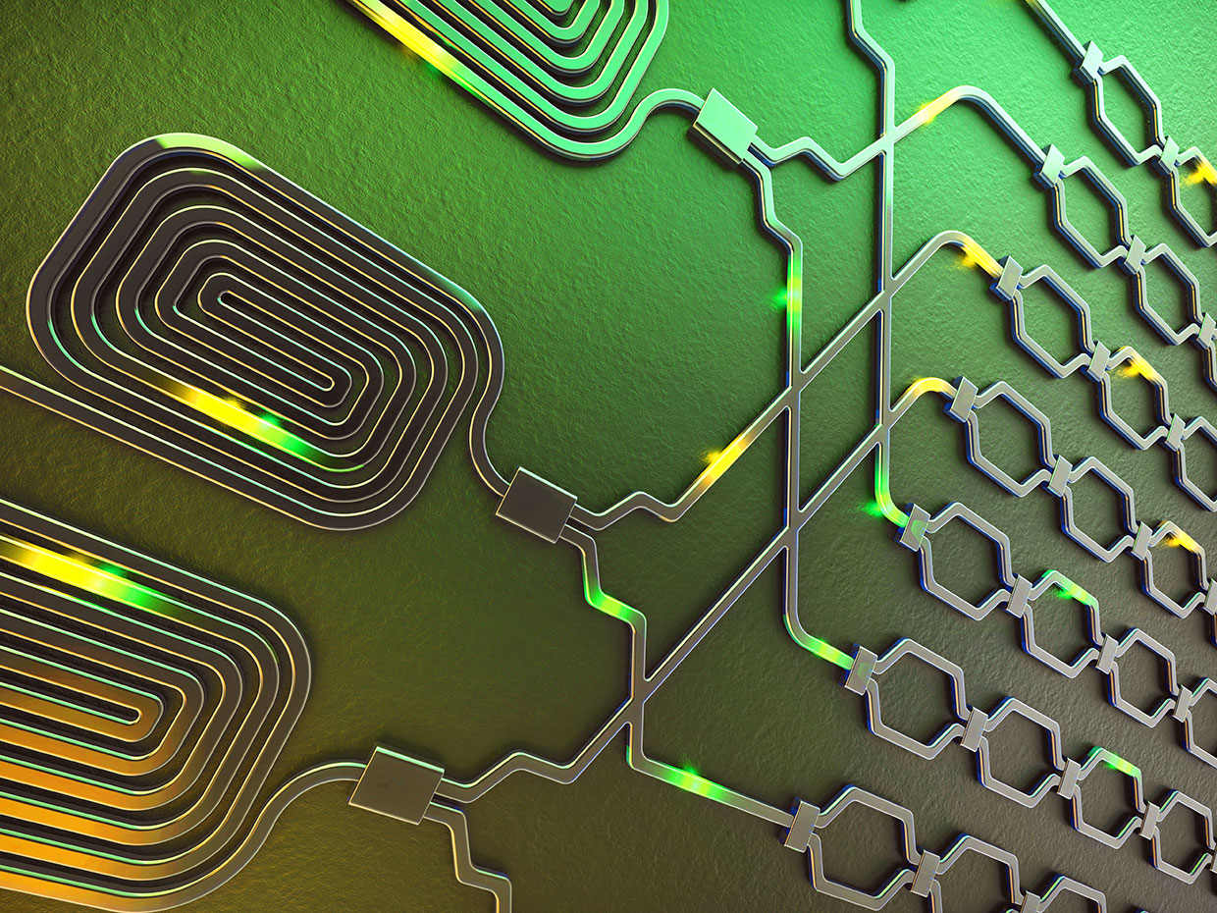
Imagine a QC with photons
Cheap to prepare
No cryogenesis system required
High clock rate
Communication-ready
However, hard to store them
Photons get lost!

Slide 4
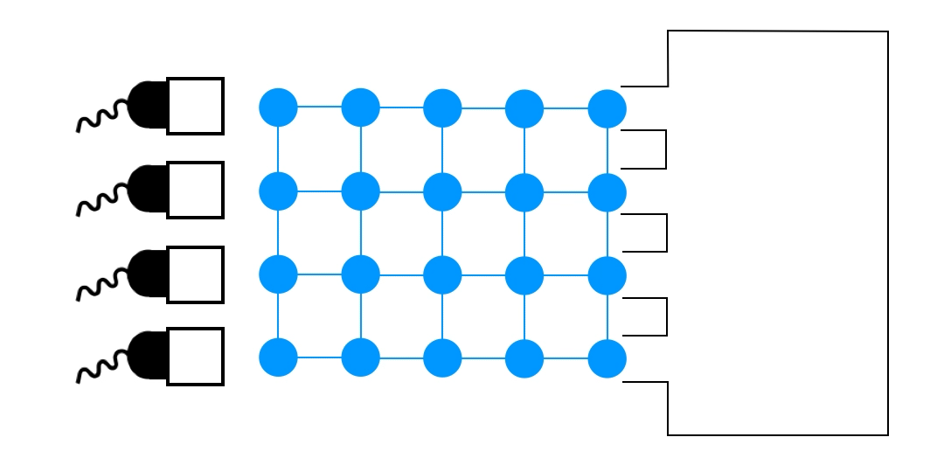
To overcome:
MBQC – generate photons and measure quickly
Error correcting codes
Notes:
Linear optics: Beam splitter, phase shifter

Slide 5
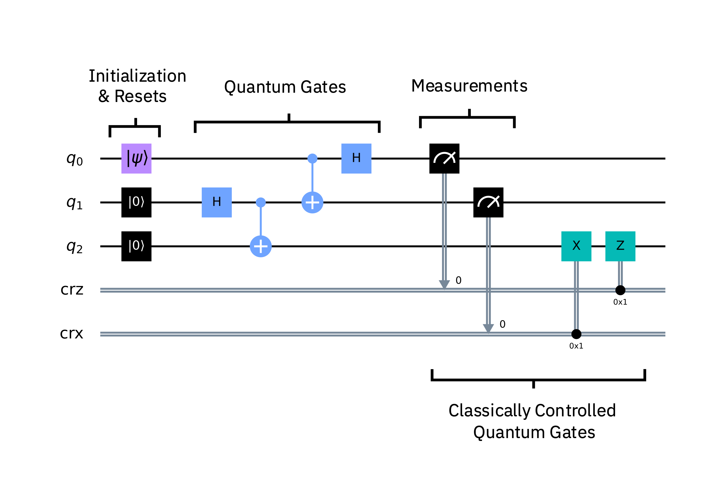
Equivalence of computation models
Circuit based
Measurement based
Picture from IBM, qiskit.org.
Raussendorf, Briegel (2001).
Picture from Gimeno-Segovia et al, PRL 115, 020502 (2015).
Notes:
Photons do not interact easily
Flying qubits
Measurement is destructive

Slide 6
3D cluster state as a foliated toric code
Requires millions of qubits;
Hard for near-term technology

Slide 7
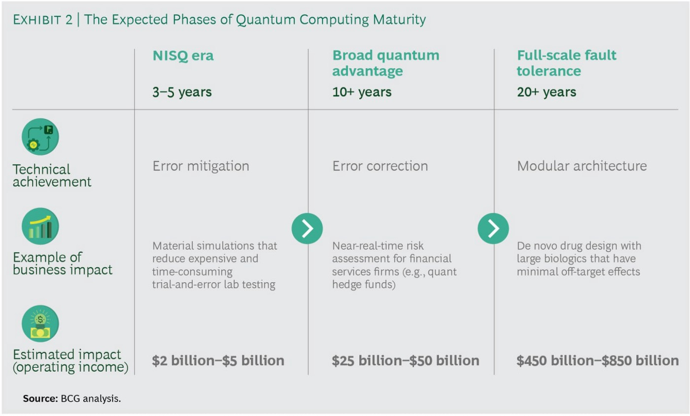

Slide 8
What can we achieve within the next 3-5 years?
Requires a technique that only deals with erasure
Notes:
100 million photons per second -> \tau= 10-100 nsec

Slide 9
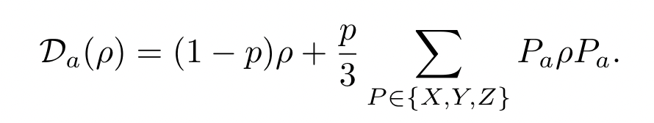
Measurement error
A general, hardware agnostic error model
Widely studied in quantum information community
Can be modified to accommodate biased noise sources

Slide 10

Case study: Hadamard Gate
Measurement pattern
Gate fidelity is approximately linear in p

Slide 11
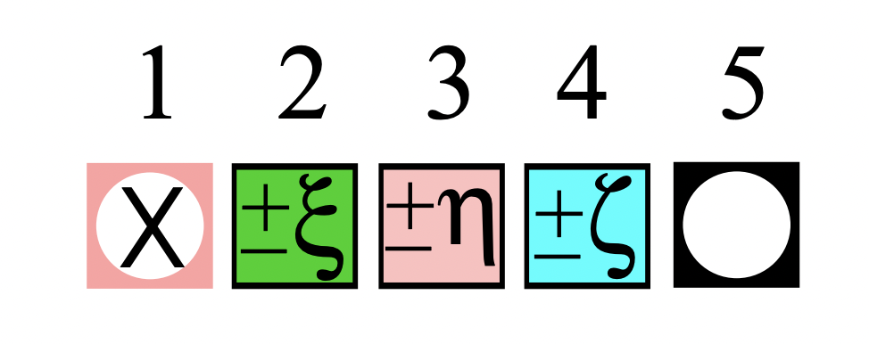
Case study: U3 rotation
Measurement pattern
Fixing p, gate fidelity is approximately independent of rotation angles
)remove

Slide 12
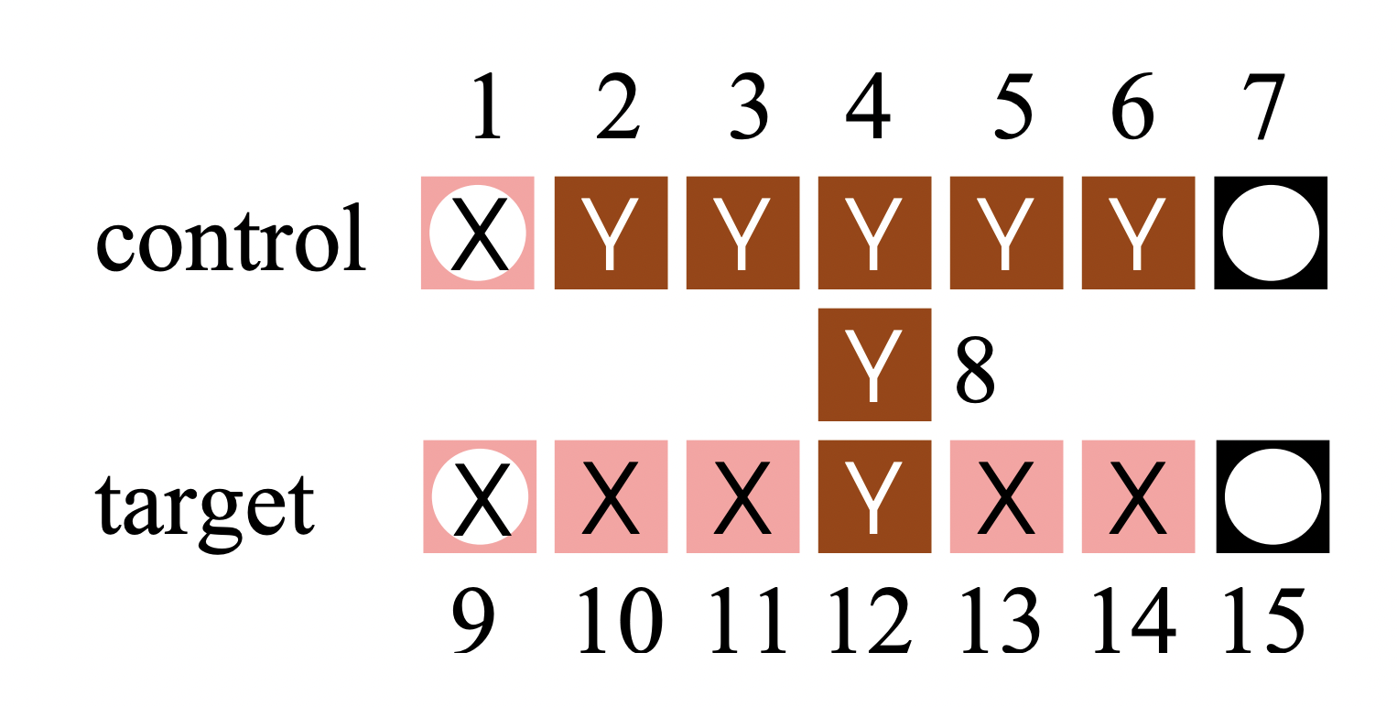
Case study: CNOT Gate
Measurement pattern
The effective error channel become non-uniform
Percent)

Slide 13
Application: estimating quantum volume
A metric that measures the capabilities and error rates of a quantum computer
Introduced by IBM, widely accepted by companies like Quantinuum
Other benchmarking tools include randomized benchmarking, cross-entropy, etc.
p = 0.01%

Slide 14
What’s next:
Consider error channel in preparing cluster states
Introduce a package to convert a CBQC circuit to a MBQC circuit
Come up with more efficient compilers
Consider physically-oriented scenarios and provide guidance for near term experimentalists

